Slide 1
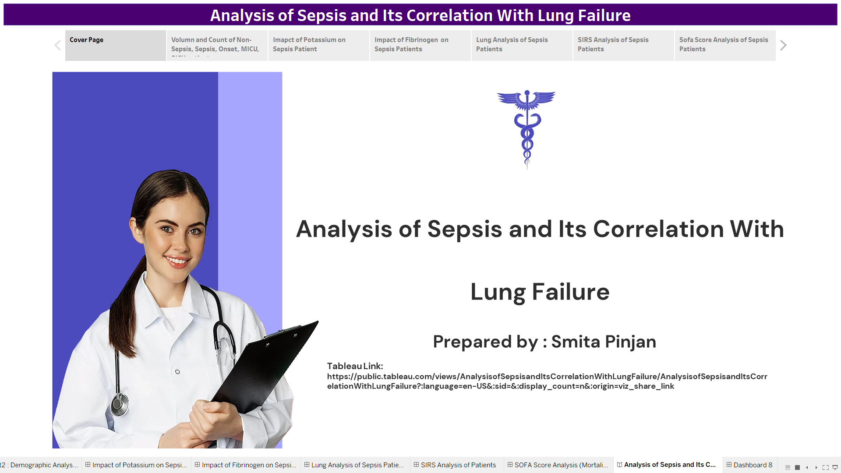
Tableau Link : Analysis of Sepsis and Its Correlation With Lung Failure | Tableau Public

Slide 2
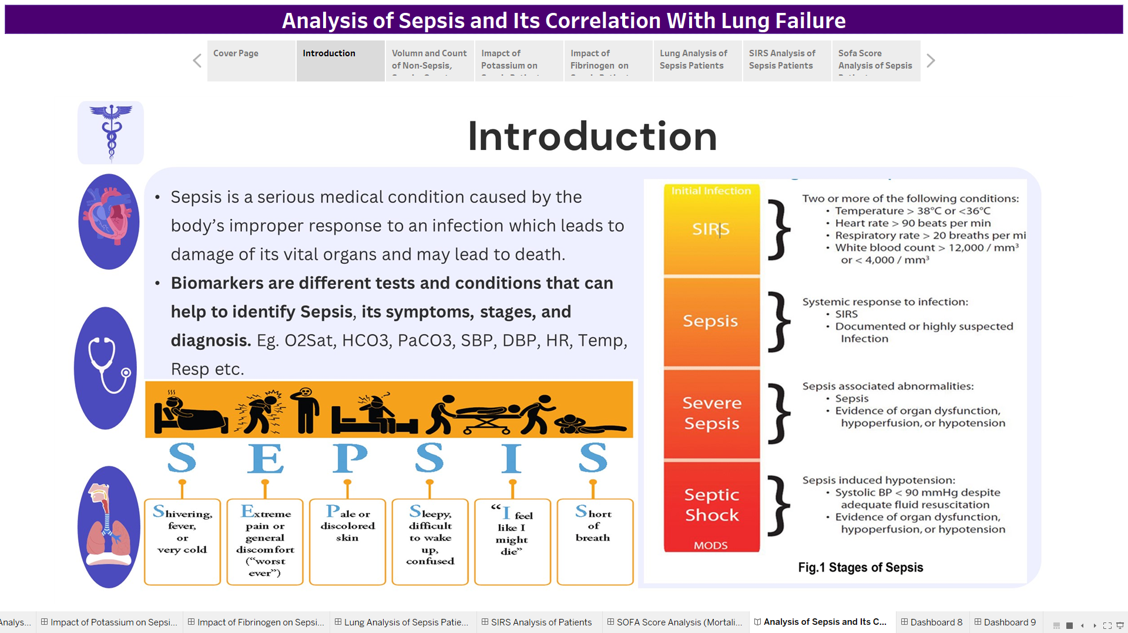

Slide 3
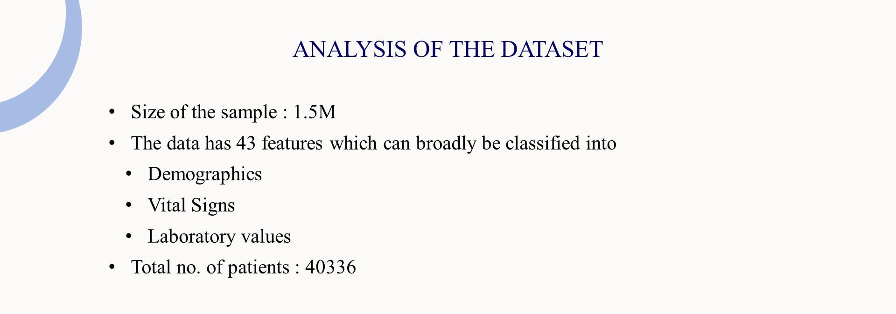
Dataset link:
https://www.kaggle.com/code/namratakapoor1/sepsis-classification/output

Slide 4
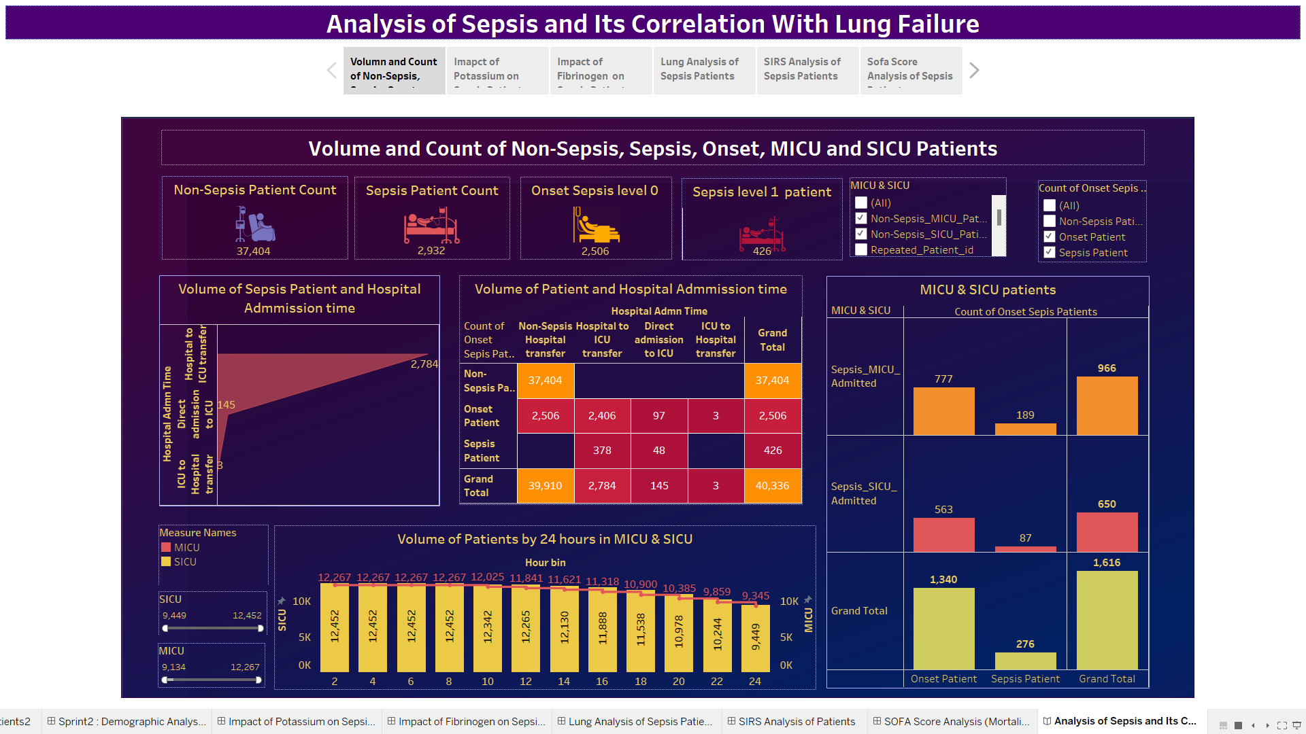

Slide 5
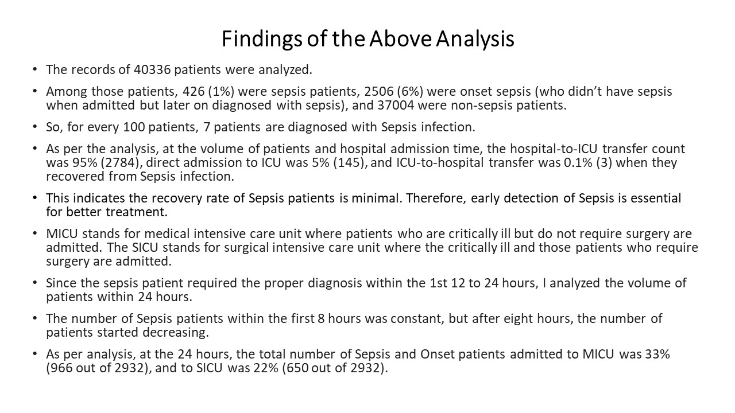

Slide 6
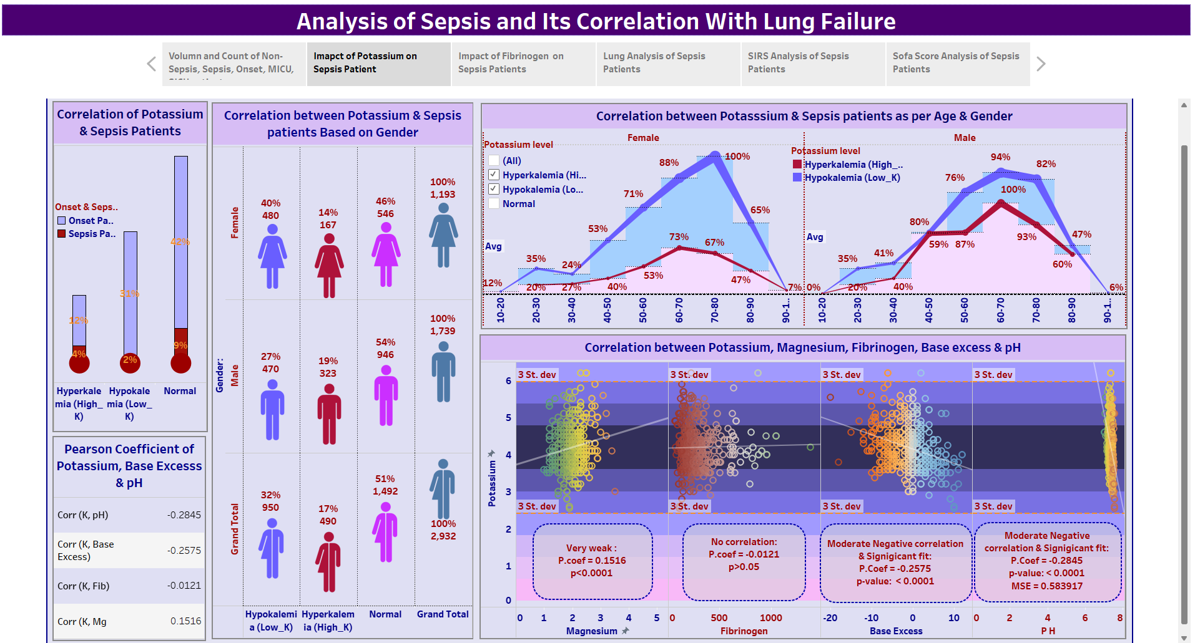

Slide 7
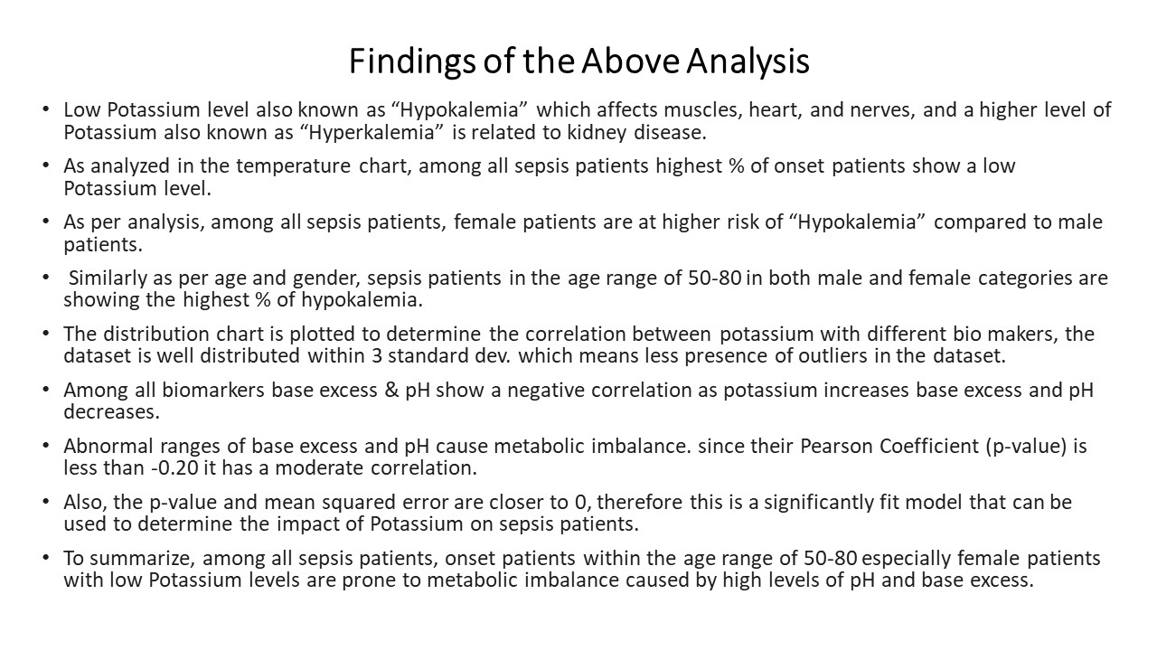

Slide 8
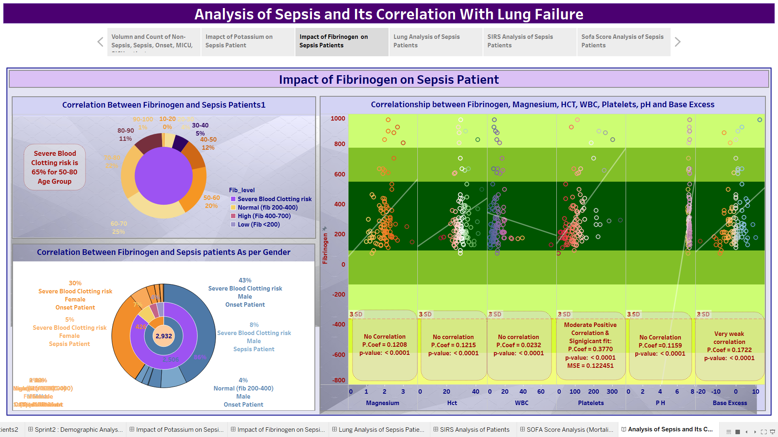

Slide 9
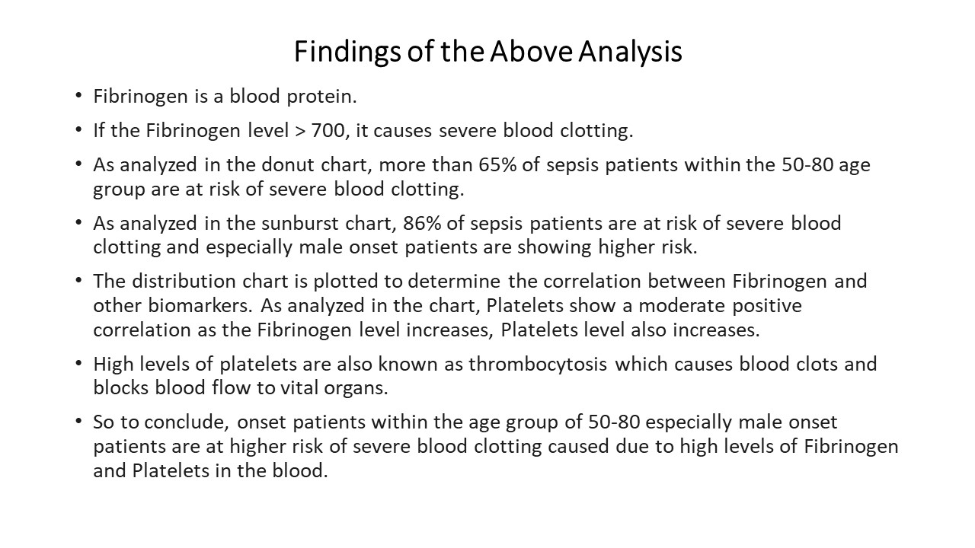

Slide 10
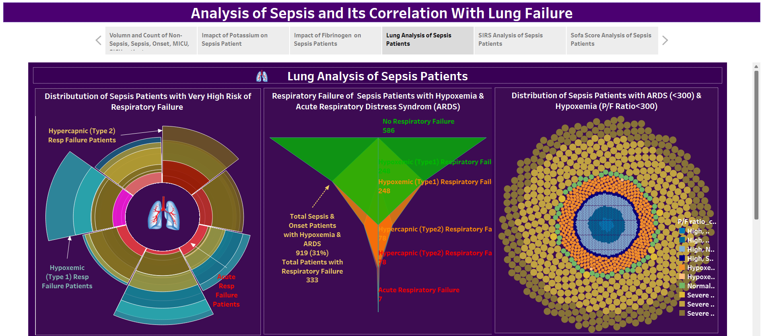

Slide 11
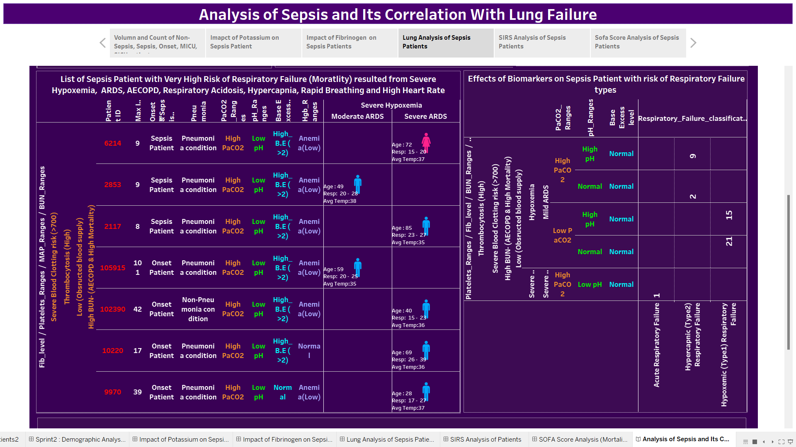

Slide 12
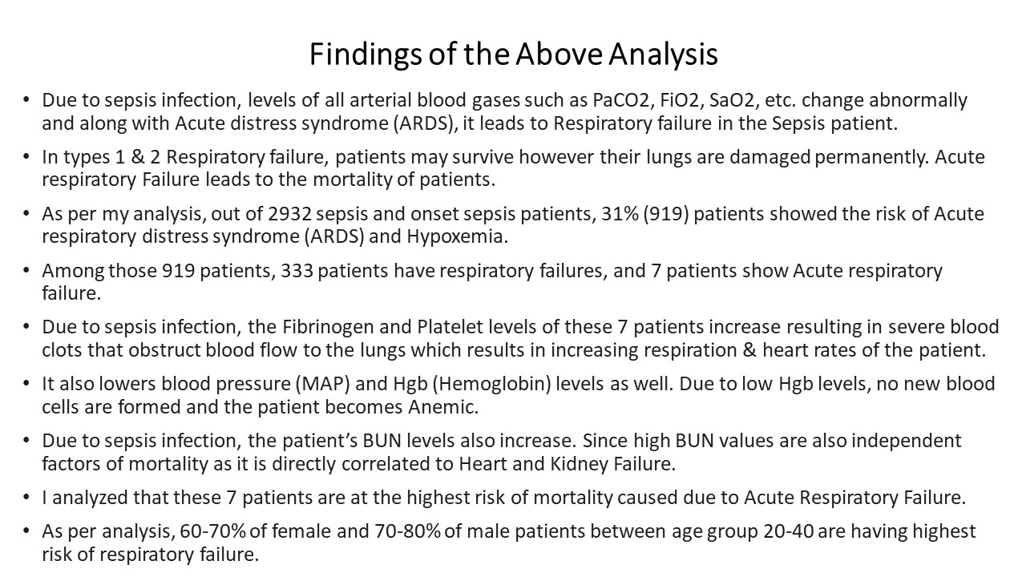

Slide 13
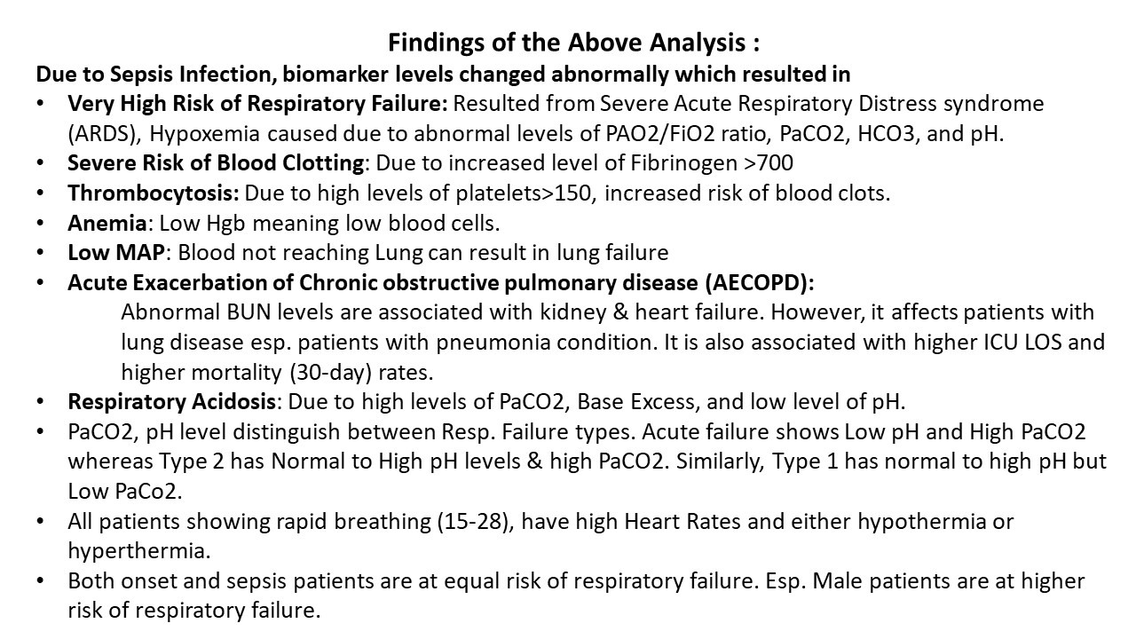

Slide 14
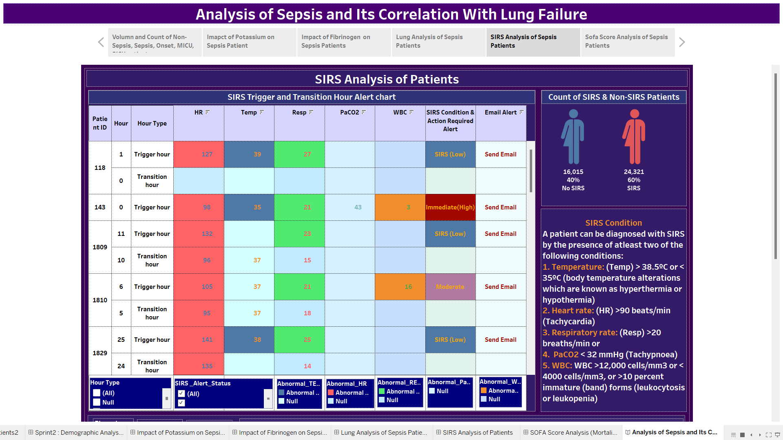

Slide 15
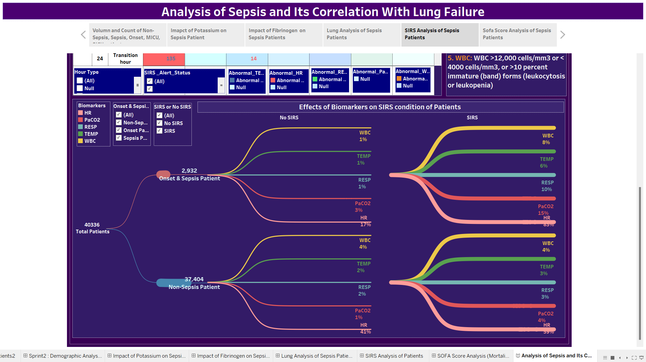

Slide 16
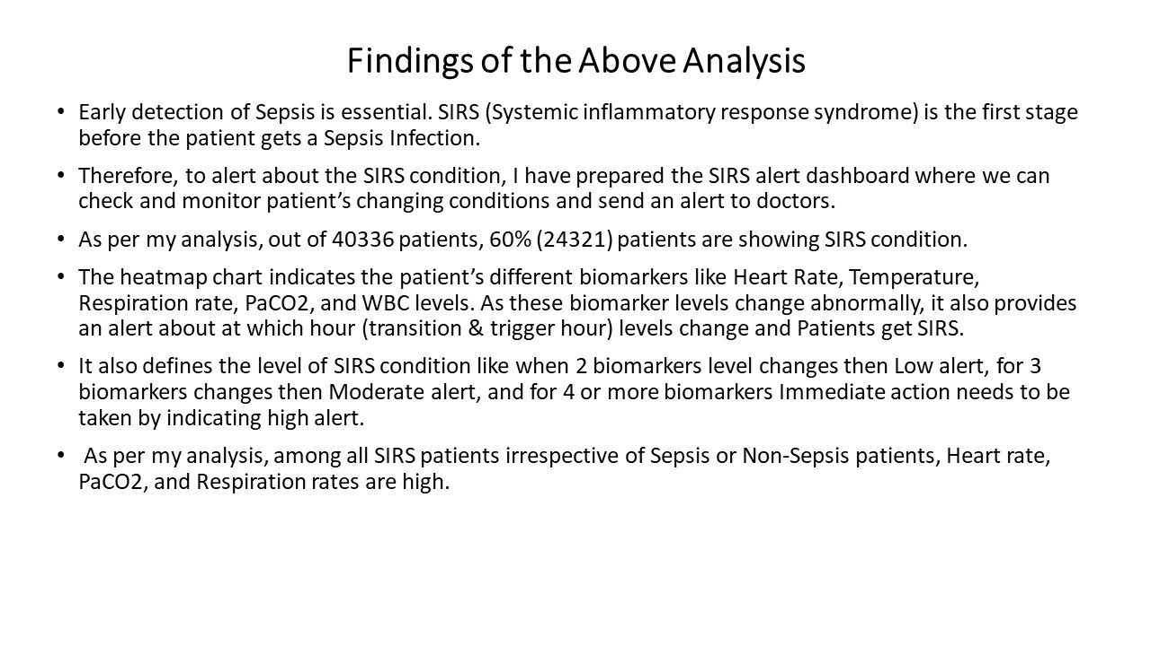

Slide 17
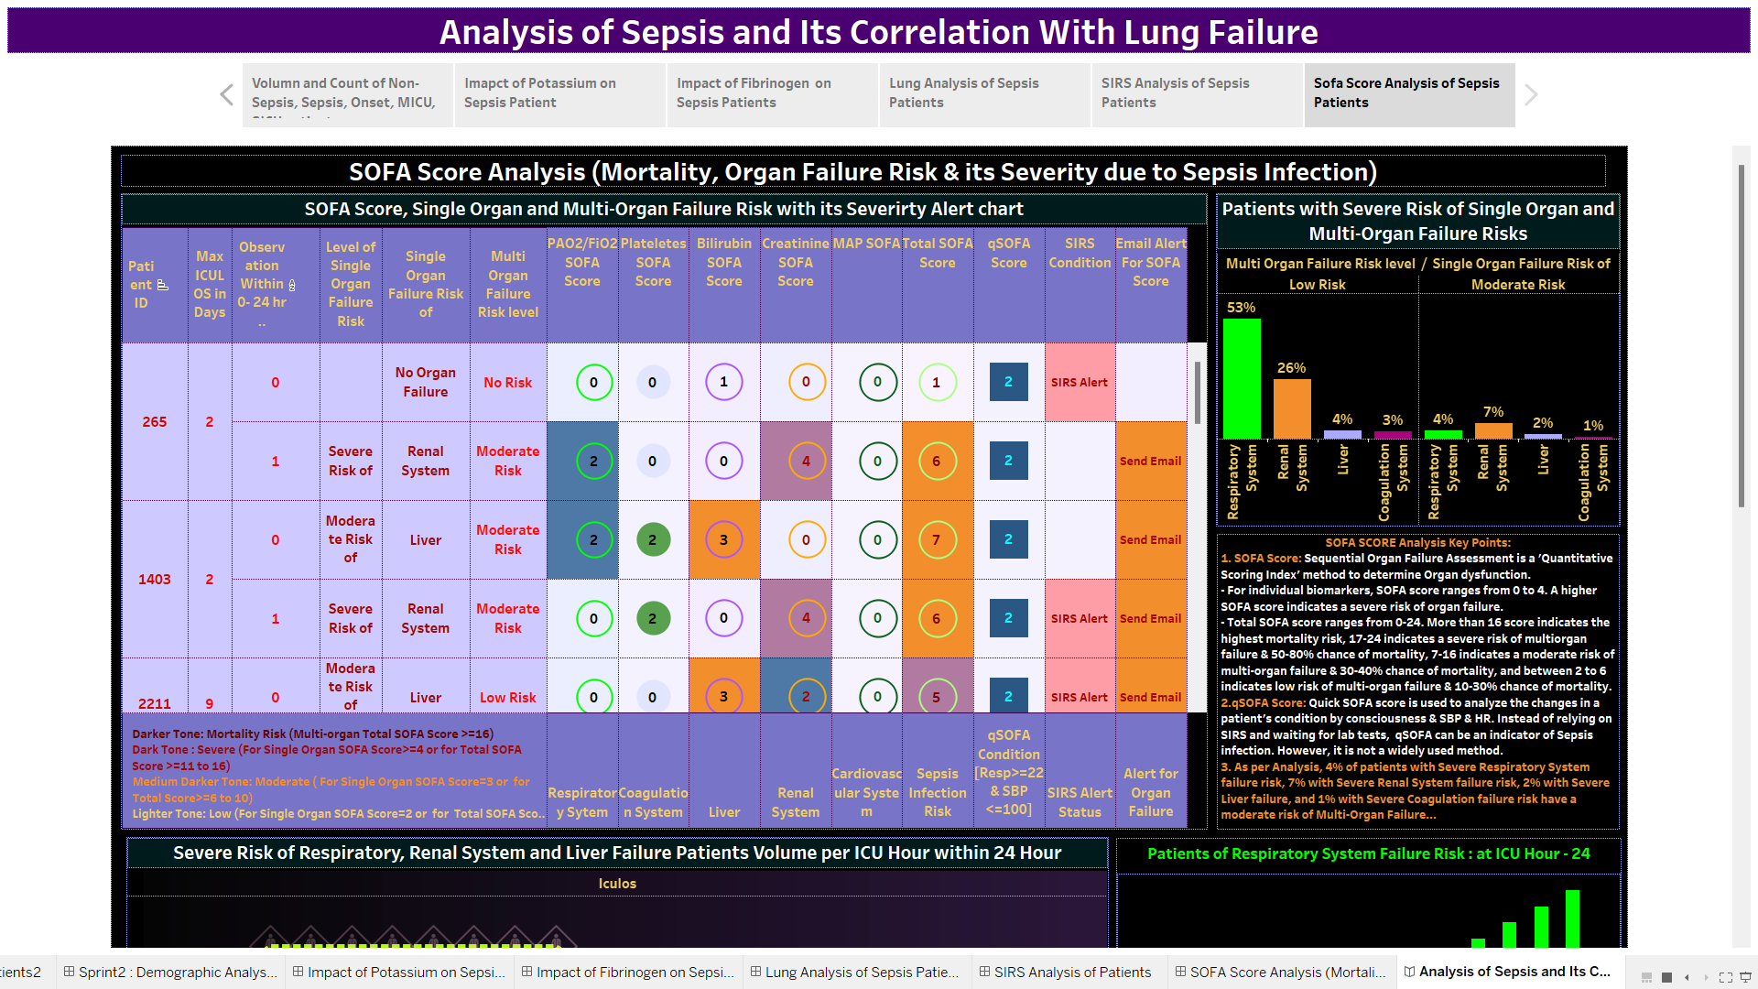

Slide 18
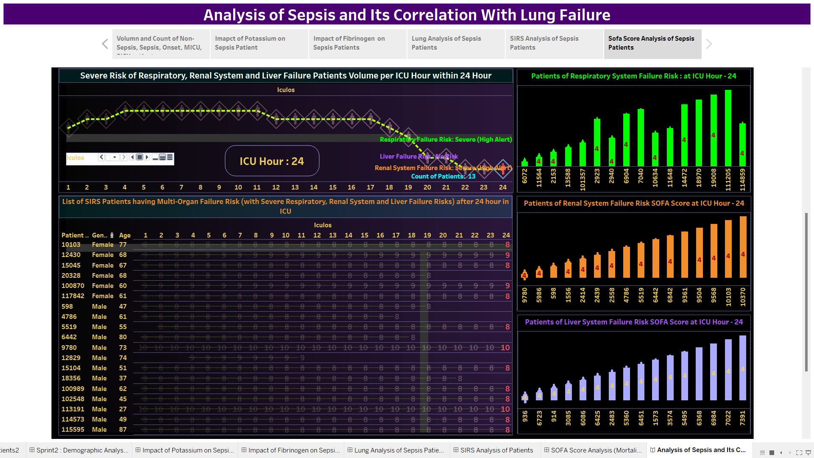

Slide 19
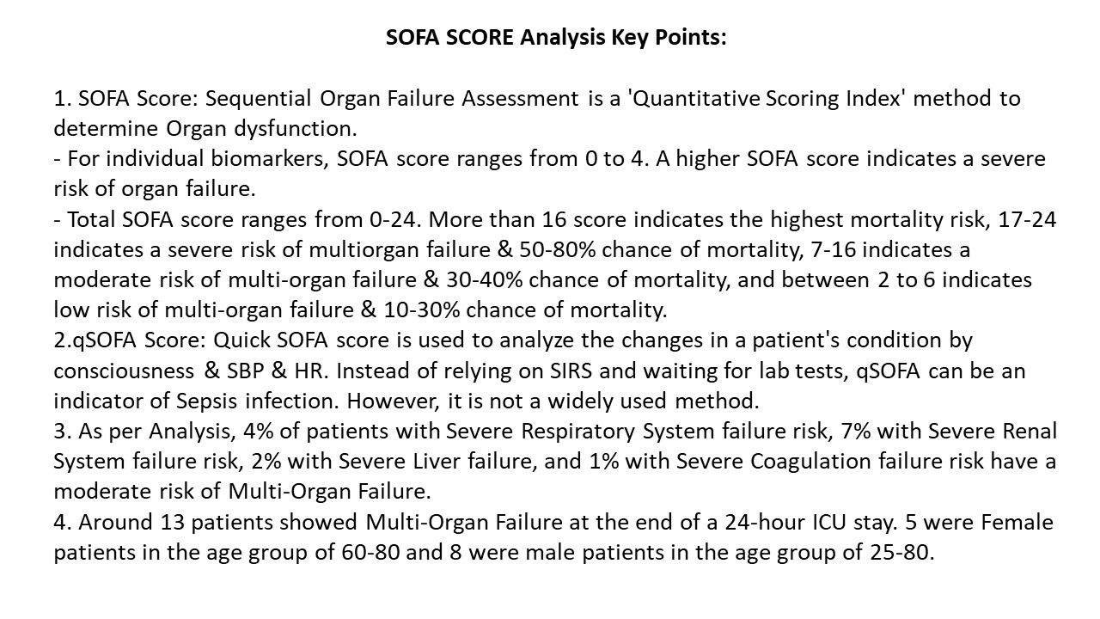

Slide 20
References
https://www.ncbi.nlm.nih.gov/pmc/articles/PMC6913810/
https://physionet.org/content/challenge-2019/1.0.0/
https://www.frontiersin.org/research-topics/56796/biomarkers-of-sepsis
https://biodatamining.biomedcentral.com/articles/10.1186/s13040-021-00235-0
https://healthmanagement.org/c/icu/issuearticle/sepsis-in-critical-care-3
https://www.verywellhealth.com/hospital-floors-and-units-3156895#toc-sicu
https://www.ncbi.nlm.nih.gov/pmc/articles/PMC6913810/#:~:text=Consequently%2C%20patients%20with%20sepsis%20might,nervous%20system%2C%20and%20hematologic%20system.
https://www.ncbi.nlm.nih.gov/pmc/articles/PMC5709181/
https://link.springer.com/article/10.1007/s001340050041
https://www.ncbi.nlm.nih.gov/pmc/articles/PMC7143675/#:~:text=Sepsis%20covers%20a%20wide%20range,according%20to%20the%20patient%20population
https://www.ncbi.nlm.nih.gov/pmc/articles/PMC8116088/
Acute respiratory distress syndrome: the Berlin Definition - PubMed (nih.gov)

Slide 21
References
https://www.healthline.com/health/fibrinogen
https://www.webmd.com/a-to-z-guides/what-is-fibrinogen-blood-test
https://www.ncbi.nlm.nih.gov/books/NBK470284/#:~:text=Sepsis%20or%20dehydration%20may%20lead,acidosis%20with%20subsequent%20potassium%20elevation
https://www.ncbi.nlm.nih.gov/pmc/articles/PMC7024748/
https://www.ncbi.nlm.nih.gov/pmc/articles/PMC7845078/
https://www.ncbi.nlm.nih.gov/pmc/articles/PMC7845078/
https://www.ncbi.nlm.nih.gov/pmc/articles/PMC8534992/
https://ccforum.biomedcentral.com/articles/10.1186/cc14095#:~:text=Patients%20with%20sepsis%2C%20who%20require,campaign%20was%20initiated%20in%202002
https://www.enherts-tr.nhs.uk/wp-content/uploads/2019/10/Post-operative-sepsis-leaflet-SAU-Final-web-1.pdf
https://www.ncbi.nlm.nih.gov/pmc/articles/PMC8116088/#:~:text=We%20found%20that%20one%2Dthird,duration%20of%20management%2015.8%20days
https://geekymedics.com/abg-interpretation/

